Slide 1
Final Project Presentation Clustering Music Genres
CS 472
Search
Home
Library
By Ethan Ferguson & Noelia Canela
Github Repo: https://github.com/noeliacanela229/music-genre-clustering/tree/main
Github Webpage: https://noeliacanela229.github.io/music-genre-clustering/
Notes:
Hey everyone, my name is Noelia and this is Ethan and today we're presenting our final project on clustering music genres. Essentially we tried to get an algorithm to figure out what genre a song is just from its audio data without ever telling it what genres exist

Slide 2
Problem Setup
Our Question:
Dataset:
Can a clustering algorithm group songs by genre just from audio data with no labels at all?
32,828 Spotify songs across 6 genres — EDM, Rap, Pop, R&B, Latin, Rock
Our Approach:
Run 6 clustering algorithms and compare them using silhouette score to find which one works best.
Notes:
So the question we started with was, can you take a song, look at things like how fast it is, how loud it is, how danceable it is, and have an algorithm sort it into a genre on its own with no labels or hints. We used a Spotify dataset with about 32,000 songs across 6 genres and we ran 6 different algorithms to see which one could do that the best.

Slide 3
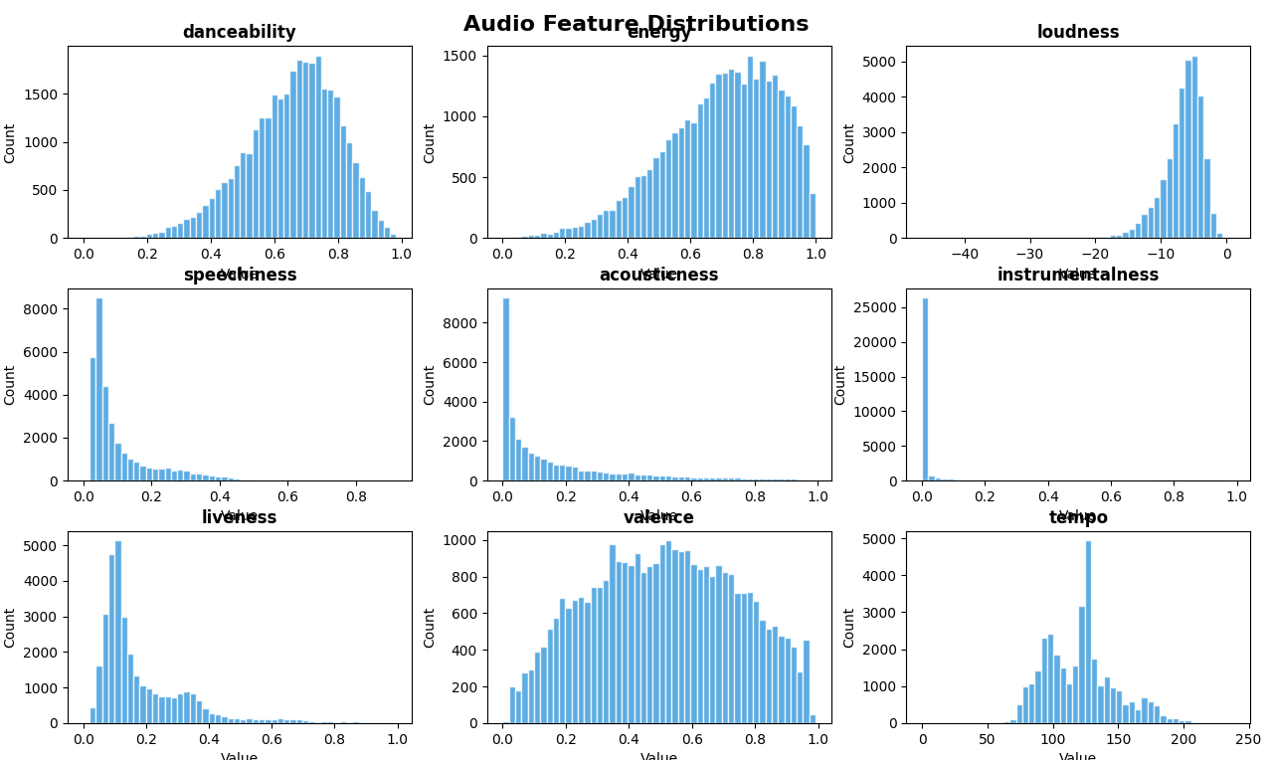
Data & Processing
32,833 songs loaded — 32,828 after cleanup
6 genres: EDM, Rap, Pop, R&B, Latin, Rock
Kept 9 audio features, dropped non-numerical columns
Applied StandardScaler
Only 5 missing rows out of 32,833
speechiness and instrumentalism heavily skewed toward zero, most songs weren’t spoken word or purely instrumental.
Notes:
Our dataset came in pretty clean, we only had 5 missing rows out of 32,000. We kept 9 audio features and dropped everything like track name and artist name since those aren't numbers the algorithms can use. The distributions on the right show what each feature looks like for example speechiness and instrumentalness are both really skewed toward zero which just means most songs in the dataset aren't heavy rap or purely instrumental.

Slide 4
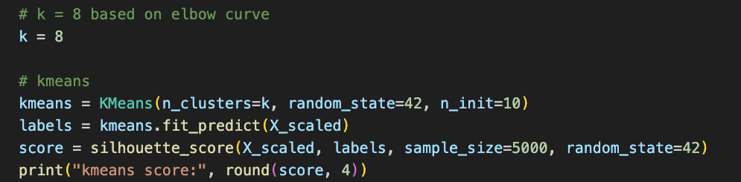
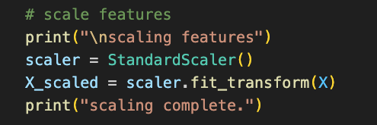
Implementation
K-Means — baseline
K-Means++ — smarter initialization
K-Medoids — uses real songs as centers
DBSCAN — density-based, finds outliers
GMM — soft probability assignments
Hierarchical Clustering — builds a tree of relationships
Notes:
We ran 6 algorithms total. K-Means is the most basic and was our baseline. K-Means++ is essentially the same thing but picks smarter starting points so it usually does a little better. K-Medoids was similar but instead of using an average as the cluster center it uses an actual real song from the dataset. DBSCAN grouped songs by how densely packed they are and flags anything that doesn't fit as noise. GMM gives each song a probability of being in each cluster instead of just picking one. And hierarchical clustering built a family tree of how genres relate to each other. The code on the right shows how we ran K-Means and measured it.

Slide 5
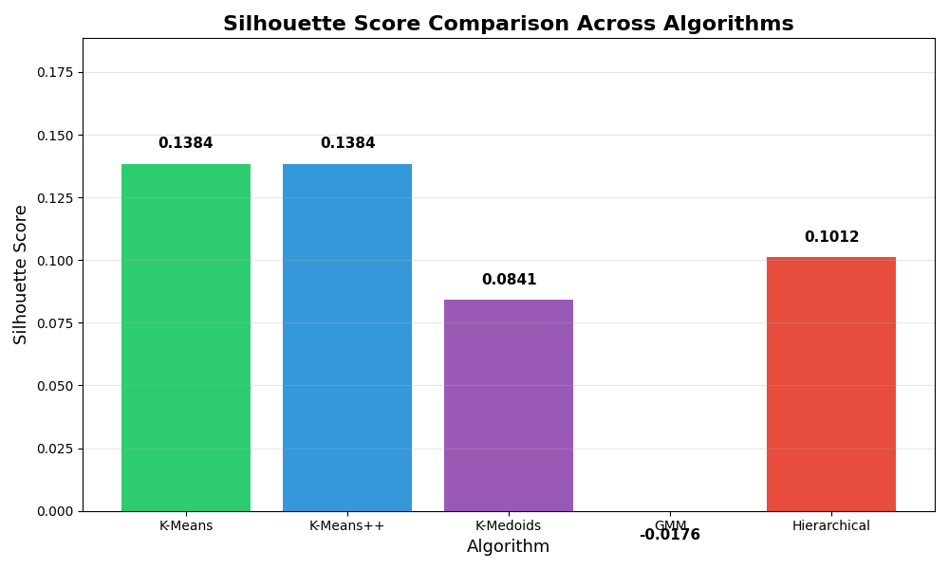
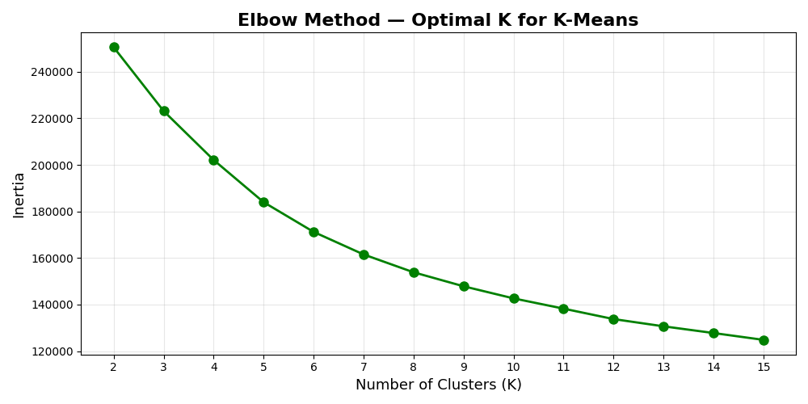
Results
K-Means and K-Means++ tied at 0.1384 — DBSCAN found 46 clusters and labeled over half the songs as noise
curve gradually flattens so we selected K=8 to allow for sub-genre separation
Next Steps / Open Questions:
Would K=6 perform better since that matches the actual number of genres in the dataset?
Could combining highly correlated features like energy and loudness improve cluster separation?
Notes:
These are our actual results. K-Means and K-Means++ both got 0.1384 which made them the best overall. DBSCAN completely fell apart meaning it found 46 clusters and labeled over half the songs as noise, which makes sense because music genres blend into each other and aren't dense enough for density-based clustering. The elbow curve on the right is how we picked K=8. We also have two open questions that came out of this, we're curious whether K=6 would actually perform better since that matches the exact number of genres in the dataset, and whether combining energy and loudness since they're so highly correlated would give us cleaner clusters.

Slide 6
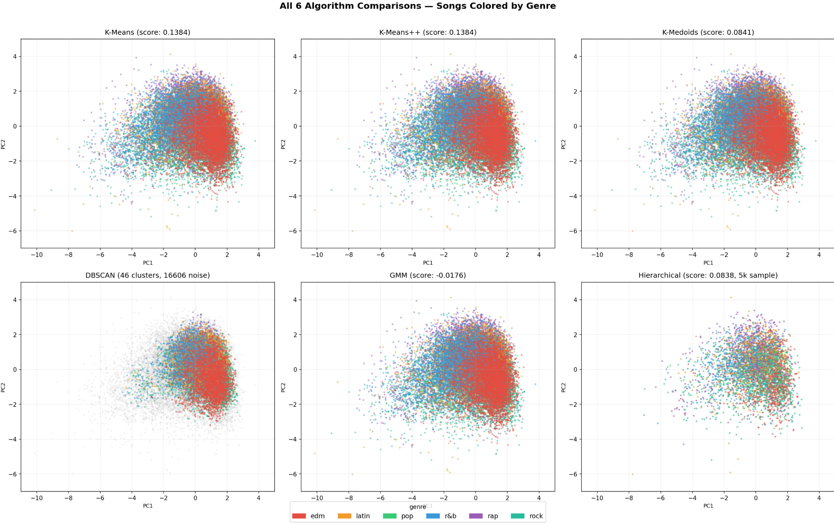
6 cluster comparisons
Notes:
This image shows all 6 algorithms plotted side by side with songs colored by their actual genre. You can see the difference in how K-Means, K-Means++, and K-Medoids all show similar structure. The DBSCAN panel is the most telling one, all those grey dots are songs it couldn't assign to any cluster, which visually confirms exactly what the silhouette scores showed.
(really focus on the grey)

Slide 7
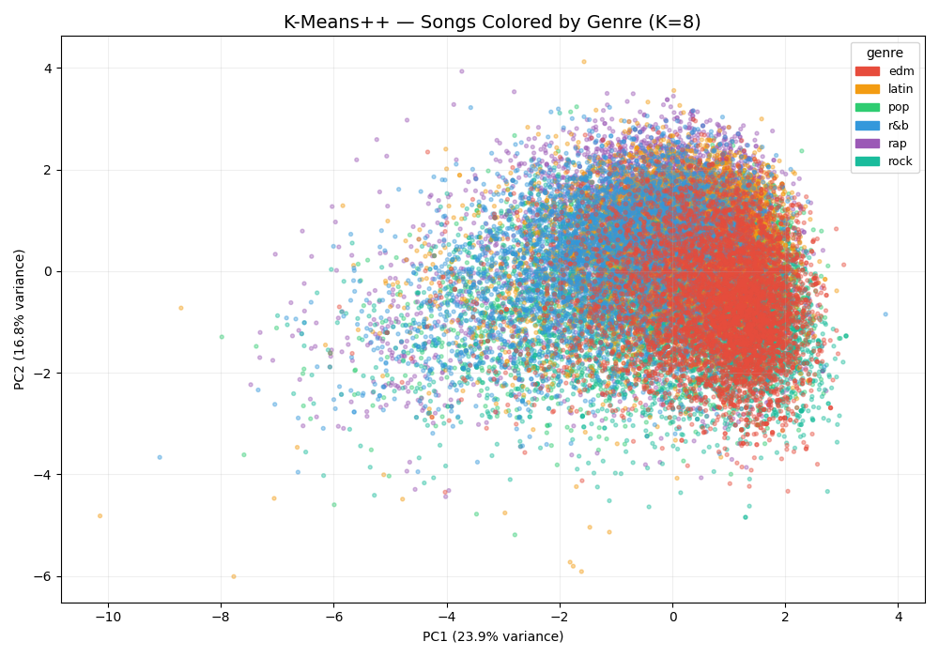
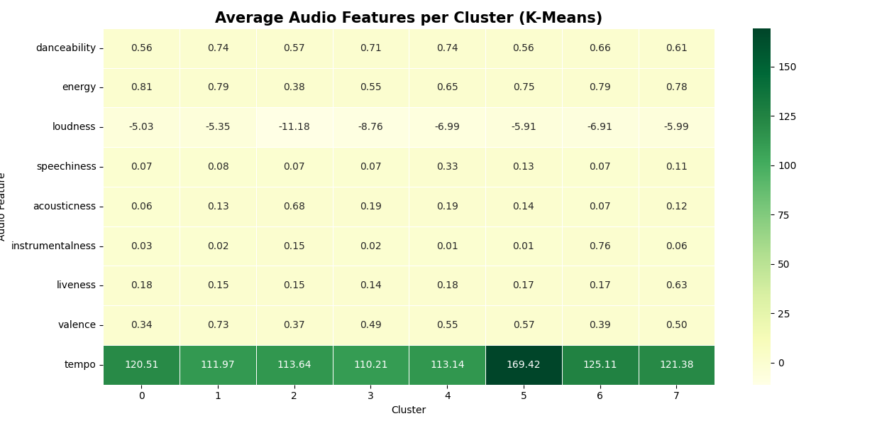
Cluster Visualizations
cluster 5 has the highest tempo at 169, which is faster than all the others
clusters overlap because genres share audio features
Notes:
The scatter plot on the left shows all 32,000 songs in 2D where each color is a different cluster. There's a lot of overlap which makes sense because genres like pop and EDM share a lot of similar audio features so the algorithm naturally puts them close together. The heatmap on the right shows what each cluster actually sounds like in terms of its audio features. The thing that stands out the most is cluster 5 where it had a tempo of 169 which is way faster than every other cluster sitting around 110 to 125.

Slide 8
BONUS: What We Did Extra
What we proposed
K-Means clustering on Spotify audio features, expanded to 6 algorithms — K-Means, K-Means++, K-Medoids, DBSCAN, GMM, and Hierarchical Clustering
2. What we did extra
Before running any algorithms we looked at how all 9 audio features relate to each other using a correlation matrix, and plotted the distribution of every feature across all 32,000 songs. This helped us understand the data and interpret our results better.
3. Why it matters.
It helped us explain why certain algorithms failed — for example we could see that speechiness and instrumentalness are heavily skewed toward zero, and that energy and loudness move together strongly. That context made it easier to understand why DBSCAN struggled and why the clusters overlap the way they do.
Notes:
For the bonus, our original proposal was just K-Means, then we expanded to 6 algorithms after feedback. On top of that we also looked at how all the audio features relate to each other before doing any clustering. We made a correlation matrix and plotted the distribution of every feature. That actually helped us explain why things worked the way they did, like seeing that energy and loudness are strongly correlated at 0.68 helped us understand why high energy genres end up in the same clusters, and why DBSCAN struggled since the data isn't spread out in the way that algorithm needs..

Slide 9
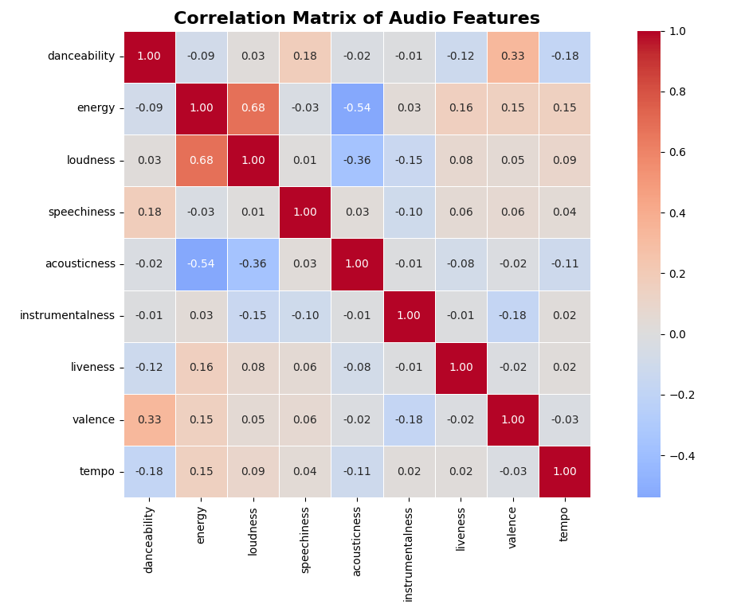
BONUS: What We Did Extra (visual)
Notes:
This is the correlation matrix we referenced earlier. Each box shows how two features relate to each other where the darker red it is the more they move together, and the darker blue the more they move in opposite directions. The biggest one we noticed was energy and loudness at 0.68, meaning louder songs almost always have higher energy too. On the other side acousticness and energy are at -0.54, so acoustic songs tend to be low energy which makes sense. Seeing these relationships beforehand helped us understand why the clusters overlap because if two genres share similar energy and loudness levels the algorithm is going to put them close together no matter what.

Slide 10
THANK YOU
Github Repo: https://github.com/noeliacanela229/music-genre-clustering/tree/main
Github Webpage: https://noeliacanela229.github.io/music-genre-clustering/
Notes:
Thank you!

